Slide 1
Recursion
By Fauzan A.

Slide 2
Section Objectives
Learn what recursion is
Learn how to trace methods with recursion
Look and analyze the Fibonacci sequence
Learn recursive sorting

Slide 3
Introduction to Recursion
By Fauzan A.

Slide 4
Lesson Objectives
Learn what recursive methods are and interpret them
Learn how the general form of recursive methods and how to code them

Slide 5
Recursive Methods
Recursive methods are methods that call themselves.
Generally, there will be a base case, case that stop the method from calling itself; however, there will be at least one recursive call.
Whenever a method calls itself, it has its own set of local variables.

Slide 6
General Form
Base Case: The case where it causes the method to terminate
Does not use recursion
Without it, the recursive method will continue calling itself.
Recursive Case: The cases that leads to base case.
Calls on itself until it no longer can call on itself because it has reached the base case.

Slide 7
Recursive Problem #1
What does the method return when computation(4) is called?
public static int computation(int j) {
if (j == 0){
return 1;
}
Else {
return 2 * computation(j-1);
}
}
computation(4) = 2 * computation(3)
16
computation(3) = 2 * computation(2)
8
computation(2) = 2 * computation(1)
4
computation(1) = 2 * computation(0)
2
computation(0) = 1
16

Slide 8
Factorials
Factorial | Equation Form | The Final Number
0! | 1 | 1
1! | 1 * 0! = 1 | 1
2! | 2 * 1! = 2 * 1 | 2
3! | 3 * 2! = 3 * 2 * 1 | 6
4! | 4 * 3! = 4 * 3 * 2 * 1 | 24
5! | 5 * 4! = 5 * 4 * 3 * 2 * 1 | 120
n * ( n - 1 )!

Slide 9
Let’s code...

Slide 10
Fibonacci Sequence
By Fauzan A.

Slide 11
Lesson Objectives
Learn what the fibonacci sequence actually is
Apply recursion to the fibonacci sequence

Slide 12
Fibonacci Sequence
A series that continuously adds the previous two numbers to get the next number
1, 1, 2, 3, 5, 8, 13, 21, 34, 55
F(n) = F(n - 1) + F(n - 2)

Slide 13
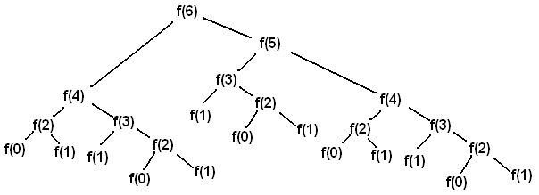
Creative Commons License

Slide 14
Fibonacci w/ Recursion
Base Case
Since F(0) has no numbers before it and F(1) only has one number before it, we utilize both of these numbers are the base case
Recursive Case
F(n) = F(n-1) + F(n-2)

Slide 15
Let’s code...

Slide 16
Recursive Searching and Sorting
By Fauzan A.

Slide 17
Lesson Objectives
Apply recursion to the binary search
Learn and analyze the merge sort algorithm
Apply recursion to merge sort an array or ArrayList

Slide 18
Find 422 With Binary Search
0
9
4
68
124
205
354
402
422
540
690
739
739
0
2
4
422
540
690
739
739
0
1
422
540

Slide 19
Merge Sort
Merge sort is a sorting algorithm that utilizes recursion to sort elements in an array or ArrayList.
“Divide and Conquer”

Slide 20
Merge Sort Functions
There are two functions within the merge sort algorithm
mergesort()
Uses recursion to keep dividing the array until it is one element
merge()
Merges two arrays into a sorted array

Slide 21
Merge sort in Practice
mergesort()
merge()
43 | 33 | 76 | 4 | 10 | 53 | 96 | 12
43 | 33 | 76 | 4
10 | 53 | 96 | 12
43 | 33
76 | 4
10 | 53
96 | 12
43
33
76
4
10
53
96
12
33 | 43
4 | 76
10 | 53
12 | 96
4 | 33 | 43 | 76
10 | 12 | 53 | 96
4 | 10 | 12 | 33 | 43 | 53 | 76 | 96

Slide 22
Thank you for watching!

